Slide 1








Housing and Ageing
Linking strategy to future delivery for Scotland 2030

Slide 2
Welcome
To plan for housing and ageing effectively for 2030, now is the time to analyse shared policy challenges and priorities across the UK, understand how they are being delivered and experienced by older people, and take forward best practice.
The proposed series of events will mobilise learning from practitioners, stakeholders and policy makers in Scotland, England and Wales by developing and exchanging knowledge between diverse geographical areas that share similar issues around housing and ageing (e.g. inequalities around rural/urban/disadvantaged communities).
The events will bring together academics, policy makers, service users and organisations delivering policy objectives in practice.

Slide 3

Who are we?
Professor Judith Phillips, Deputy Principal (Research) and Professor of Gerontology
Dr Vikki McCall, Head of Housing
Dr Alasdair Rutherford, Senior Lecturer in Social Statistics
Dr Jane Robertson, Lecturer in Dementia Studies
Dr Melanie Lovatt, Lecturer in Sociology
Dr Ryan Woolrych, Associate Professor in Urban Studies
Professor Judith Sixsmith, Chair in Health Related Research

Slide 4

Jeremy Porteus, Managing Director, Housing Learning and Improvement Network
Zhan McIntyre, Public Affairs
Dr Friederike Ziegler, Researcher in Urban Planning and Ageing
Jim Eadie, Housing lead for Age Scotland

Slide 5
Our Strategic
Programme
Final Conference Event
Practitioner Working Group
Stakeholder Working Group
Policy-makers and Influencers Working Group
Co-designed, evidence-led set of recommendations for the UK, Scottish and Welsh Governments
An international network for Housing and Ageing

Slide 6
Our approach underpinning the programme
Ageing in the Right Place
Housing &Home
Community
Care & Technology
Place and Belonging
Underpinned by adventurous qualitative methodology

Slide 7
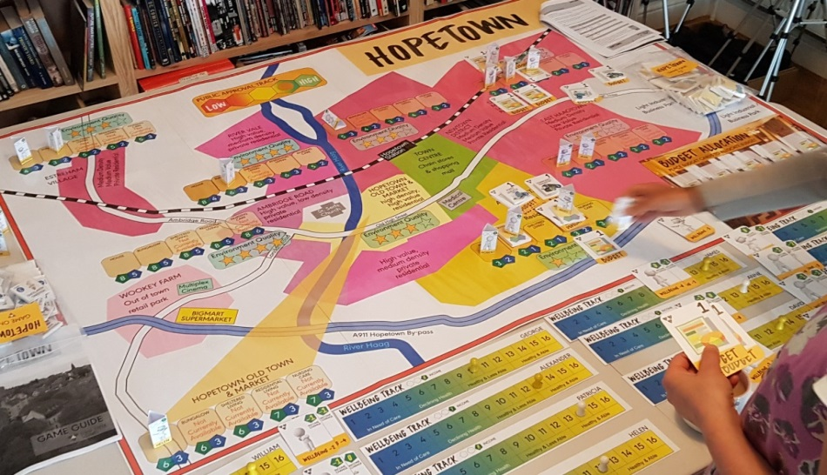
The ‘Serious Game’
A ‘Serious Game' - a bespoke, personalised, strategic exercise - will be delivered today to allow you to negotiate potential obstacles for delivering Housing and Ageing strategies by 2030.
The game will facilitate knowledge exchange by involving participants in taking on different perspectives within policy and practice, and managing different scenarios.

Slide 8


The Rules
Chatham House Rule - information disclosed during the events may be reported by those present, but the source of that information may not be explicitly or implicitly identified.
We will be recording your feedback today via ‘reporters’ – our PhD students – taking notes. Names will not be recorded.
Remember we are gathering qualitative evidence about topics, discussions, decisions etc – all responses will be anonymised.
We will be taking photos and tweeting about the event (please sign our form!) #housingandageing – if you do not wish to have your photo taken please let the photographer know.
Remember this is all voluntary, and if you want to opt out of the research element of the event please just let us know.

Slide 9
Todays agenda
 |  | Leading
09.00 | Arrive and refreshments
09.15 | Welcome and outline of event | Vikki McCall
09.30 | Address from the Minister for Local Government and Housing | Kevin Stewart MSP
10.00 | Address from the Minister for Housing and Regeneration | Rebecca Evans AM
10.30 | Background of policy development and processes – how can we learn from each other in England, Scotland and Wales? | Judith Phillips and Vikki McCall
10.45 | Ageing in Place – looking at housing from a more holistic perspective | Ryan Woolrych and Judith Sixsmith
11.00 | Break
11.15 | Where are we in Wales? | Led by Judith Phillips
11.35 | Where are we in Scotland? | Led by Jim Eadie
11.55 | Where are we in England? | Led by HousingLIN
12.15 | Briefing on the Serious Game | Jim Wallman
12.30 | Lunch and knowledge exchange across the UK, Scottish and Welsh experiences and scenario planning | ALL
14.45 | Briefing and summary | Jim Wallman
15.15 | Recommendations for the UK, Scottish and Welsh Governments | Vikki McCall

Slide 10
Final conference event
The final conference event will present the findings and analysis of the three working groups to integrate policy-maker, practitioner and service user knowledge to inform the implementation of the strategies.
To produce co-designed, evidence-led recommendations for the UK and devolved governments on supporting delivery of Housing and Ageing strategies for 2030.
2nd July 2018

